Slide 1
Auto Generation of Diagnostic Assessments
and their Quality Evaluation
Soma Dhavala, Chirag Bhatia, Joy Bose, Keyur Faldu and Aditi Avasthi
Embibe, Bangalore, India
Notes:
Couple of lines about Embibe:
Embibe is an online EdTech company with a sole mission to improve learning outcomes for millions of children

Slide 2
Problem Statement
A good test paper is one that has the following characteristics:
Accuracy: The test paper should be able to accurately diagnose the ability level of a student for the skill set being evaluated
Discrimination: It should be able to discriminate between students of different abilities.
It should be able to meet these objectives using as few questions as possible.
In this work, we present an approach to
select questions from a question bank, using configurable policies, that meet the above criteria.

Slide 3
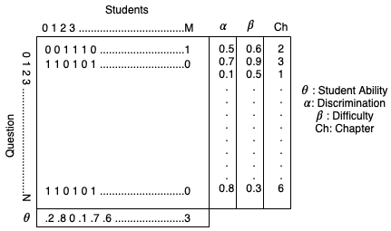
Data
Item metadata:
Pedagogic
Subject
Chapter
Concept)
Behavioural
Wasted Attempts Ratio
Overtime Incorrect Ratio
…
Item characteristics (2PL IRT)
difficulty
discrimination

Slide 4
Two-parameter (2PL) Item Response Theory (IRT) model
We use the 2PL IRT model to calibrate our test papers.
As per the 2PL IRT model, the probability or likelihood of the student answering a question correctly is given by the following equation:
P(X = 1|θ, α, β) = e^{α(θ−β)} / (1 + e^{α(θ−β)} )
Here, θ represents the student’s skill/ability level, α represents the discrimination factor of the question, β represents the difficulty level of the question and P represents the probability that the student will answer correctly.

Slide 5
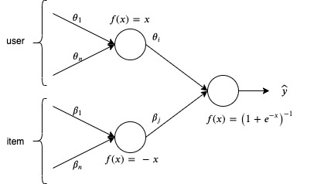
Neural net to infer IRT parameters
We infer the IRT model parameters (α, β, θ) from our ground truth dataset by fitting a fully connected deep neural network modeled using Keras

Slide 6
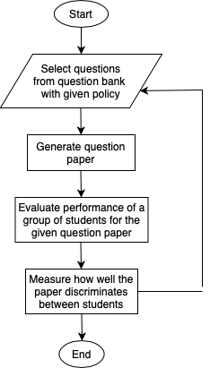
Policy for question paper generation
The questions are indexed in a database indexed on the metadata fields.
A query is formed to fetch relevant questions from the db. The query is progressively refined to get a right of set of questions.
We use genetic algorithms to refine the query, and improve the search performance

Slide 7
Candidate policies
Baseline policy π_{BSP} :
As a baseline, we select N questions from the ground truth dataset, by randomly selecting over other question attributes after ensuring a mix of difficulty levels and syllabus coverage.
Discrimination only policy π_{DOP} :
We select N questions from the ground truth dataset, ensuring syllabus coverage, but also ensuring that the overall discrimination factor of the questions is maximized
Discrimination+behavior policy π_{DBP} :
In this policy, we incorporate behavior parameters along with discrimination, difficulty and syllabus coverage, while selecting questions.

Slide 8
Quality evaluation criteria
Evaluation using RMSE: We compute the root mean squared error (RMSE) between the ground truth ability and inferred ability to get a measure of the accuracy.
Evaluation using Spearman’s ρ: We sort the abilities of students obtained from the ground truth data and from the generated test, and determine the rank correlation ρ between the two ranks.
Evaluation using scatterplots: We plot the abilities of students, inferred from the ground truth, against the diagnosed abilities from the generated test papers. The degree of scatter gives an indication of how much the ability matches the inferred ability.

Slide 9
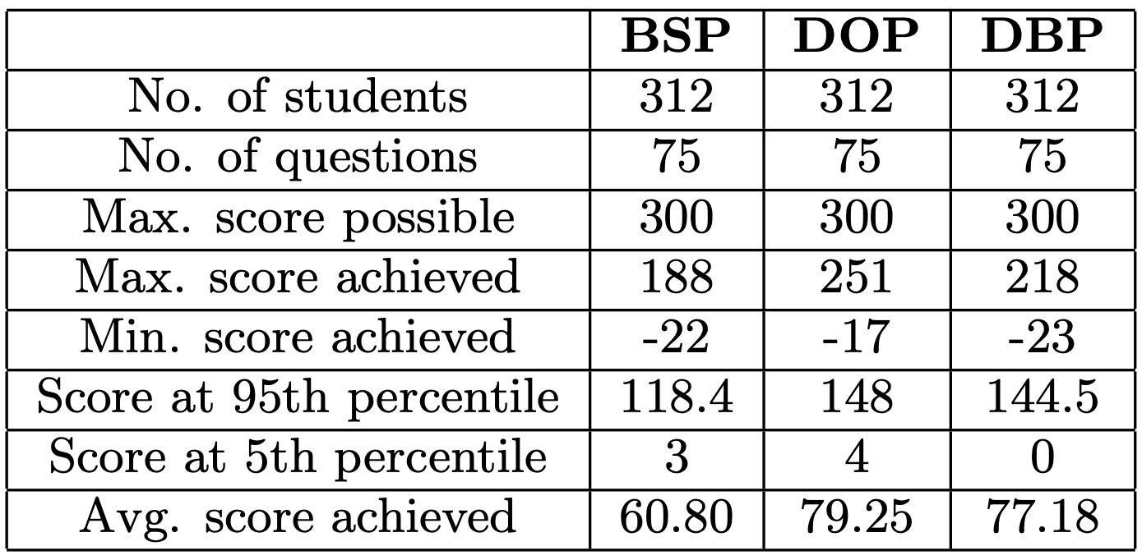
Test results from simulated tests using the policies

Slide 10
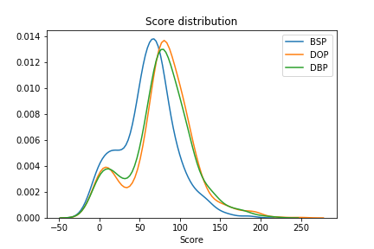
Spread of scores for the simulated tests

Slide 11
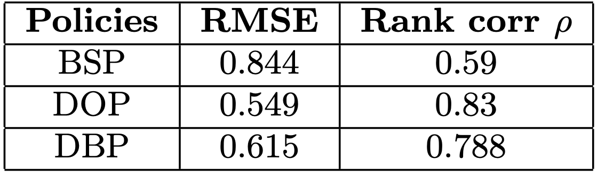
Comparison of RMSE and Rank correlation ρ

Slide 12
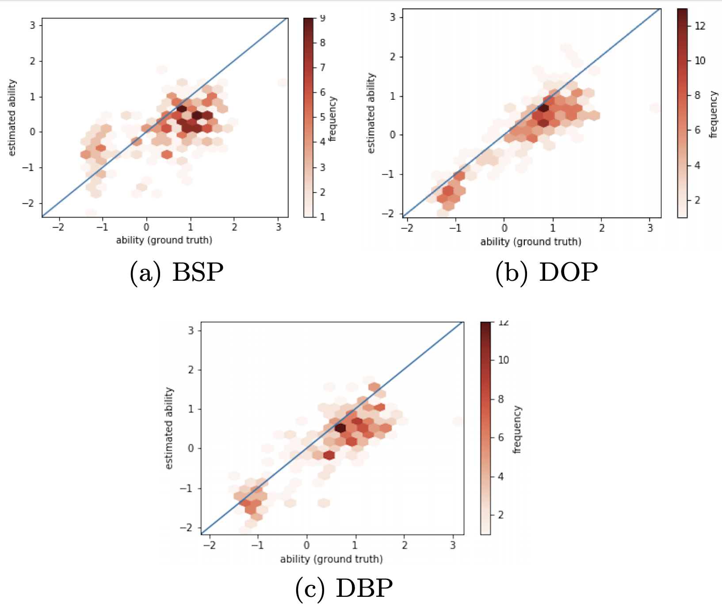
Comparison using scatter plots

Slide 13
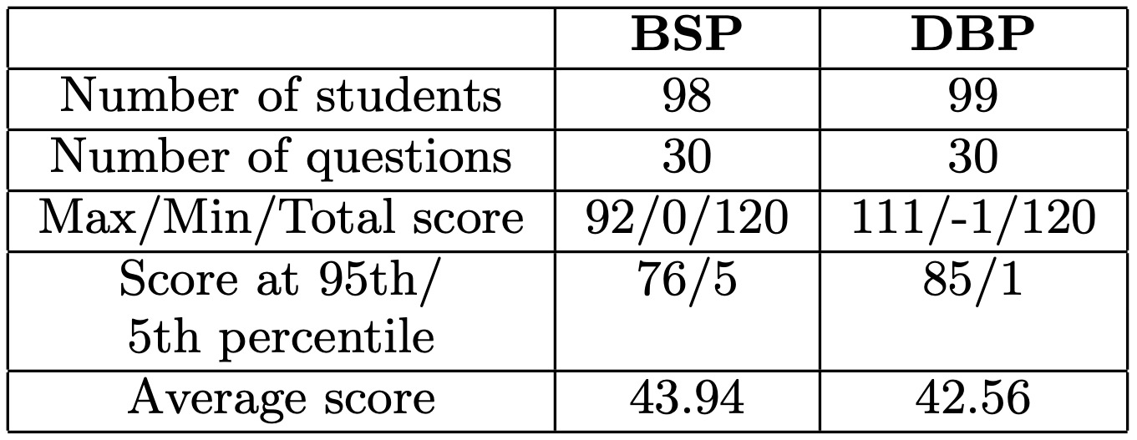
Pilot test results

Slide 14
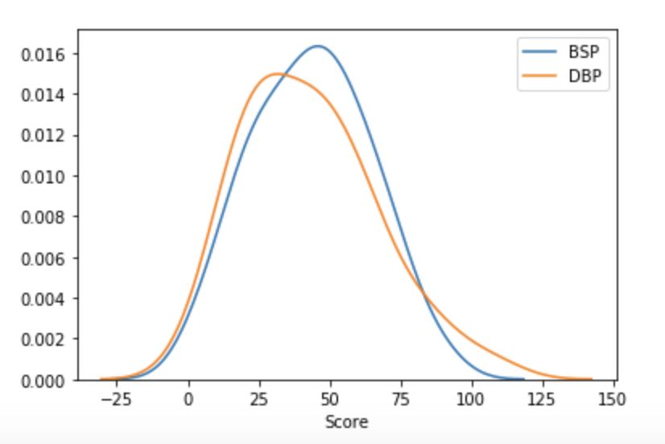
Pilot test results (continued) : Spread

Slide 15
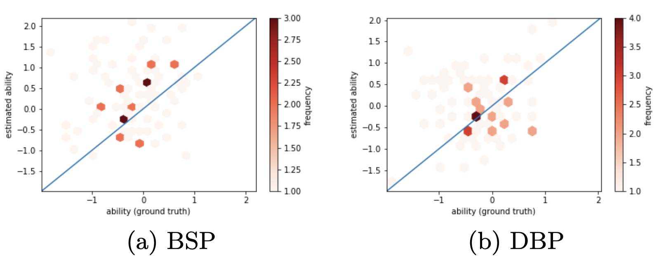
Pilot test results (continued) : Scatter plots

Slide 16
Results from the experiments
We obtained a better spread for the diagnostic policies (DOP and DBP).
The higher accuracy of the inferred ability for the DBP pilot test is confirmed by a lower value of the RMSE and lesser degree of scatter compared with BSP.

Slide 17
Conclusion
We proposed a few policies to generate test papers by selecting a list of questions from a question database.
We validated the policies by a pilot test of test papers generated using two policies.
We found that the policy of selecting questions based on highest discrimination ability for a given difficulty level yielded the best results.

Slide 18
Future Work
Extend classical IRT models to include Behavioural Parameters

Slide 19
Acknowledgements
The authors express their gratitude to Anwar Sheikh, Nishit Desai and their teams for helping us conduct the pilot study

Slide 20
References
Guang Cen, Yuxiao Dong, Wanlin Gao, Lina Yu, Simon See, Qing Wang, Ying Yang, and Hongbiao Jiang. A implementation of an automatic examination paper generation system. Mathematical and Computer Modelling, 51, 2010.
John Michael Linacre. Computer-adaptive testing: A methodology whose time has come. Development of computerized middle school achievement test, 69, 2000.
Frank B. Baker. The basics of item response theory. ERIC, USA, 2001.
G. Gage Kingsbury. Adaptive item calibration: A process for estimating item parameters within a computerized adaptive test. GMAC conference on computerized adaptive testing, 2009.
Guido Makransky. An automatic online calibration design in adaptive testing. Journal of Applied Testing Technology, 11(1), 2014.
Wim J. van der Linden and Peter J. Pashley. Item selection and ability estimation in adaptive testing. Elements of adaptive testing, Springer, 2009.
Ou Lydia Liu, Brent Bridgeman, and Rachel Adler. Measuring learning outcomes in higher education. Educational Researcher, 41, 2012.
Sideridis GD Tsaousis, I and AA Sadaawi. An irt–multiple indicators multiple causes (mimic) approach as a method of examining item response latency. Frontiers in psychology, 9, 2018.
Ryszard Jaworski. Personalization and calibration of the control question in the control question test. Journal of Forensic Identification, 61(5), 2011.
Shayan Doroudi, Vincent Aleven, and Emma Brunskill. Where’s the reward?: A review of reinforcement learning for instructional sequencing. International Journal of Artificial Intelligence in Education, 2019.
Keras documentation. https://keras.io, 2015.
Ronald K Hambleton and Wim J Linden. Handbook of modern item response theory. Volume two: Statistical tools. CRC Press, USA, 2016.

